Slide 1


Audiance Parts

Slide 2
OUR COMPANY
Started out as SALBU Enterprise in 1986, the reputation for being one of the industry’s trusted and acknowledged retailers and suppliers of Automotive Aftermarket Parts was established. The demand expanded providing an opportunity to open several sister companies within Laguna and Cavite locations. In 2020, AUDIANCE PARTS OPC (Formerly Salbu Silang Auto Supply) is established as One Person Corporation.
Audiance Parts OPC former (Salbu Silang Auto Supply) has been recognized as one of the leading suppliers and retailers of Automotive Aftermarket and Industrial Parts mainly focused at CALABARZON areas. The Company provides individual consumers with an extensive selection of quality and best value products and services.
Today, the variety of products and services are continuously growing aiming to become one of the leading suppliers nationwide.

Slide 3
Related Companies
Automotive Parts (aftermarket)
SALBU Automobil Supplies Inc. – Nat’l Highway, Parian, Calamba City
STALWART Auto Parts OPC - Nat’l Highway, Sala, Cabuyao City
ANLURICH OPC – Sta Rosa – Tagaytay Road, Putting Kahoy, Sialng, Cavite
LAGUNA Auto-Industrial Bearing Inc. - Nat’l Highway, Real, Calamba City
E-commerce Business
Lazada/ Shopee – Anamallo Automotive (BOSCH)
Lazada / Shopee – Anamallo Corporation (Power Tools)
Lazada / Shopee – SALBU (Vic, Sakura, Isuzu Genuine Parts, Bendix, Fleetmax, NGK, Depo and other automotive products)
Lazada / Shopee – Anlu Car Care (Tires and other products)
Lazada / Shopee – Audiance Auto Parts (Vic, Sakura, Isuzu Genuine Parts, Bendix, Fleetmax, NGK, Depo and other automotive, oils and lubricants products)

Slide 4
VISION STATEMENT
Audiance Parts OPC aims to become one of the leading suppliers of Automotive and Industrial Parts and Services nationwide. We are committed to providing Best Value Quality Products and Services at competitive prices.

Slide 5
MISSION STATEMENT
To provide best solutions, mutual trust, personalized service, and True Satisfaction to our valued customers

Slide 6
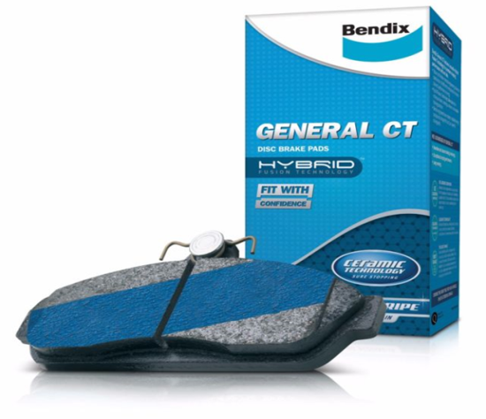
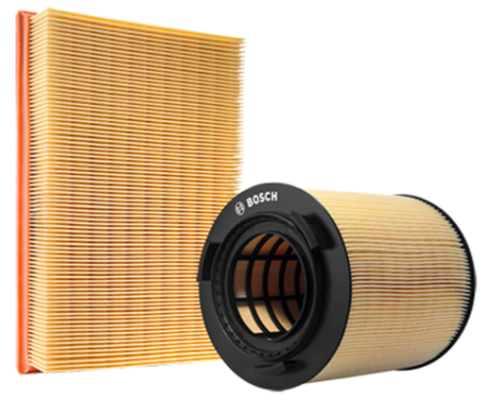
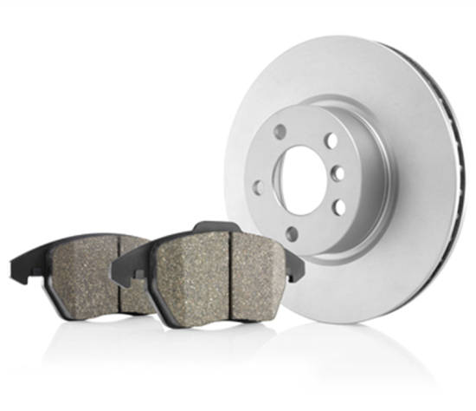
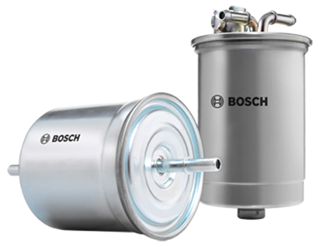
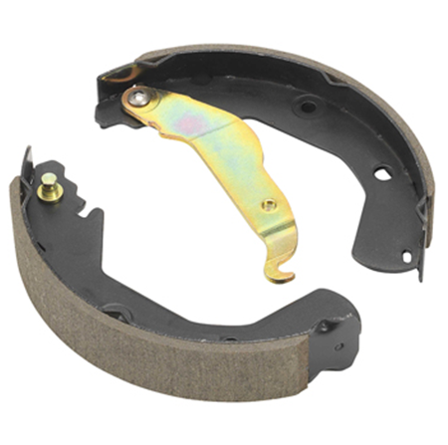
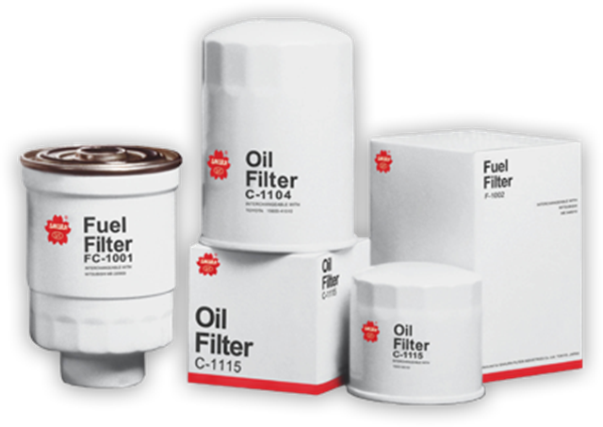
PRODUCT LINE – Automotive Parts
Braking Components
Filters

Slide 7
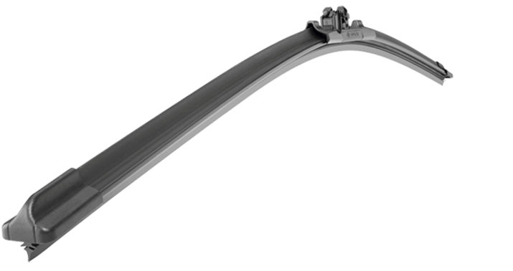
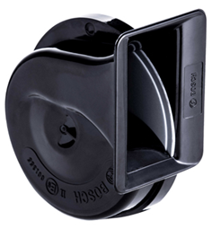
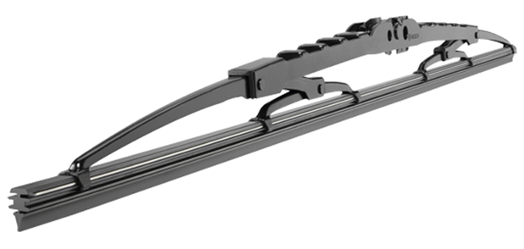
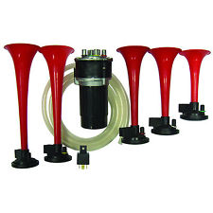
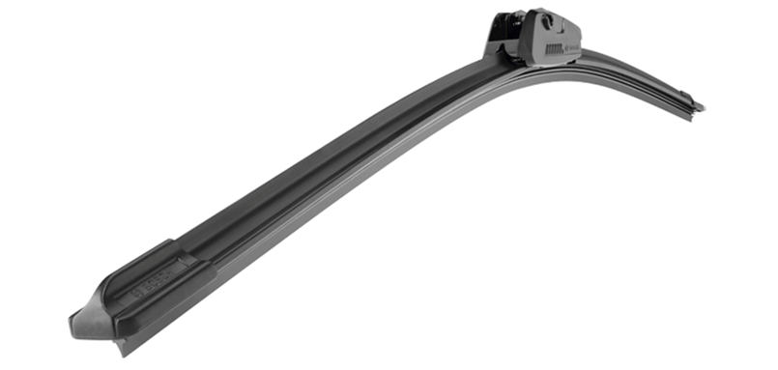
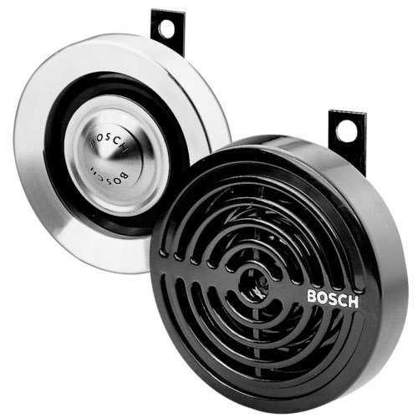
PRODUCT LINE – Automotive Parts
Braking Components
Wiper Blades
Horns

Slide 8
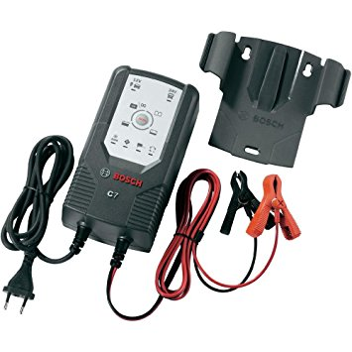
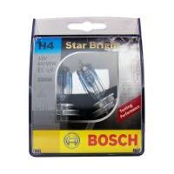
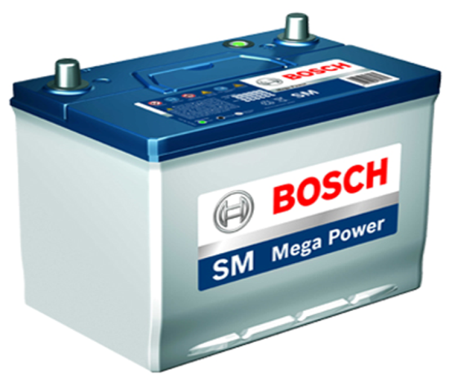
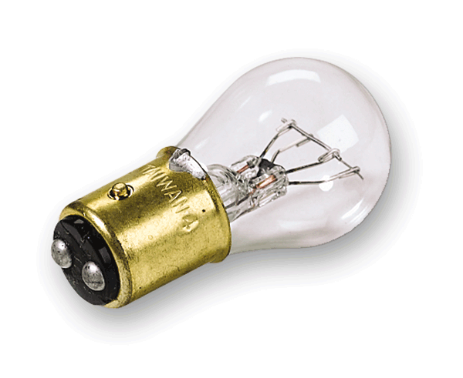
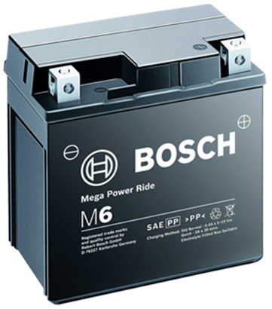
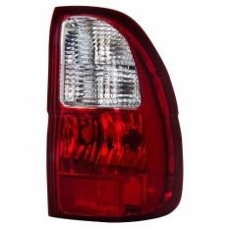
PRODUCT LINE – Automotive Parts
Braking Components
Batteries
Lights and Lamps

Slide 9
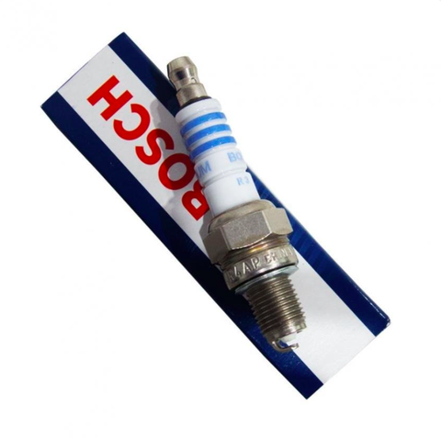
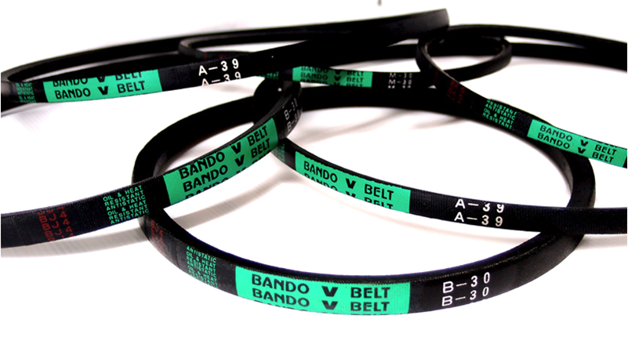
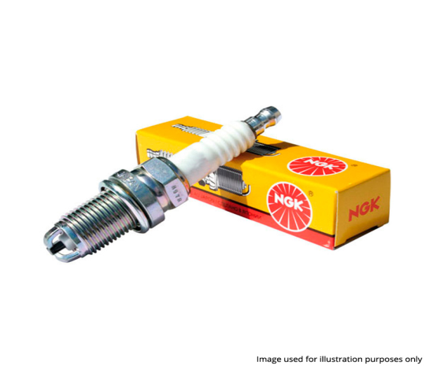
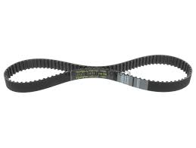
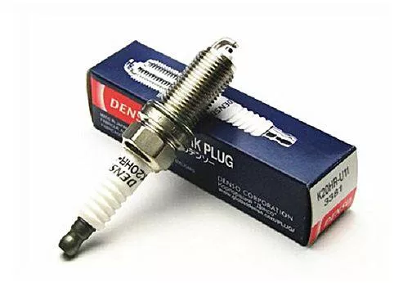
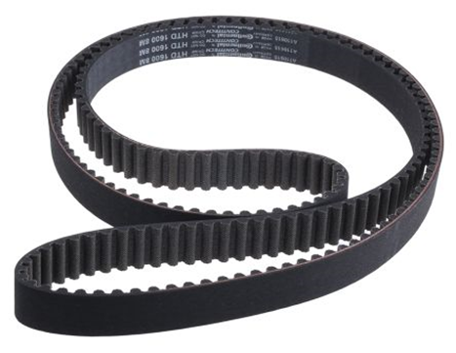
PRODUCT LINE – Automotive Parts
Braking Components
Spark Plugs
Belts

Slide 10
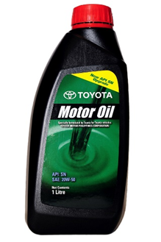
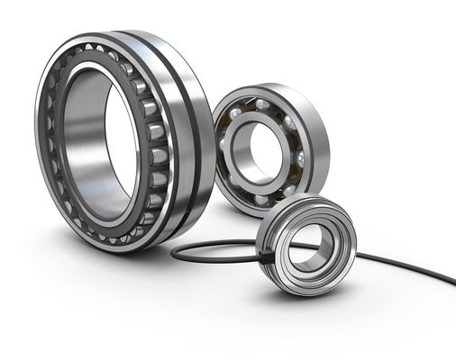
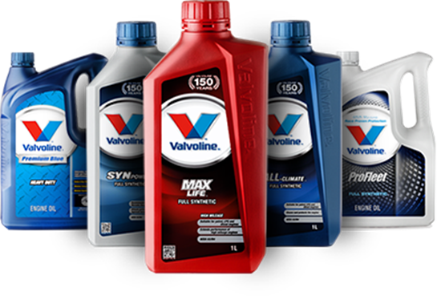
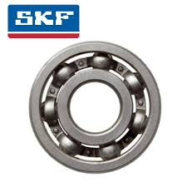
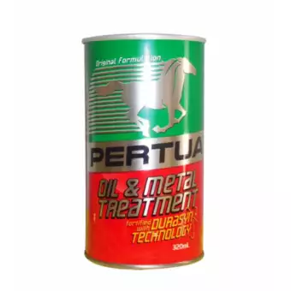
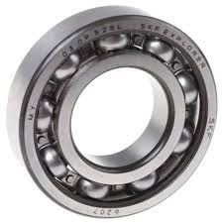
PRODUCT LINE – Automotive Parts
Braking Components
Oils and Lubricants
Bearings

Slide 11
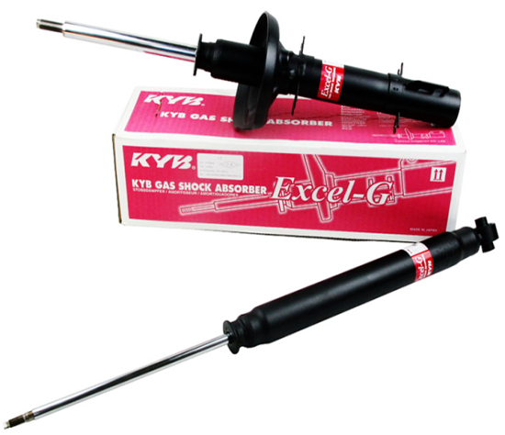
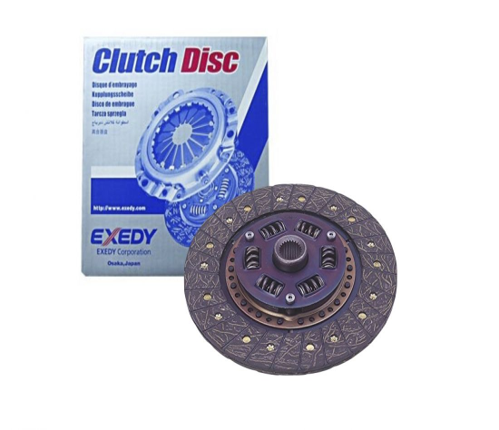
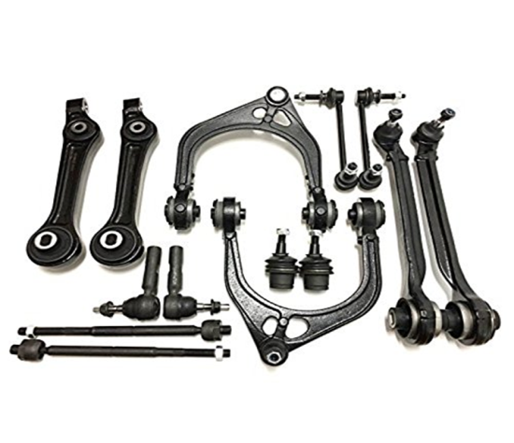
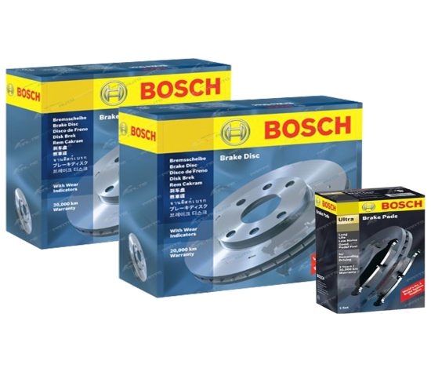
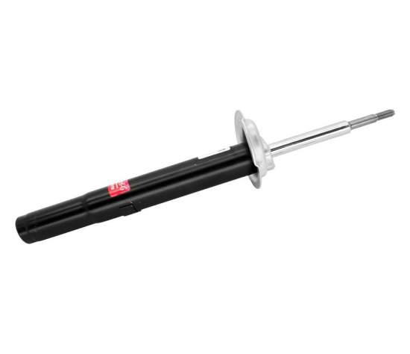
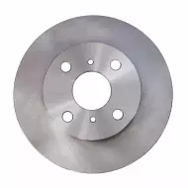
PRODUCT LINE – Automotive Parts
Braking Components
Suspension System
Clutch System

Slide 12
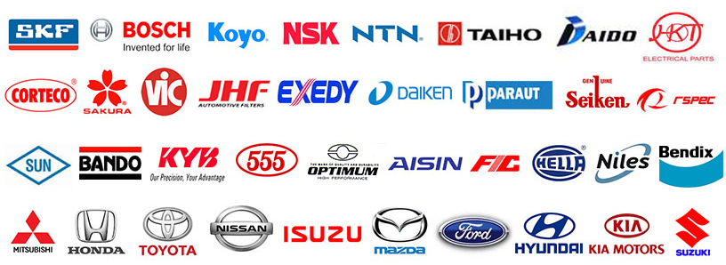
BRANDS WE CARRY
Braking Components
* Official and Authorized Distributor of BOSCH, SKF and ISUZU GENUINE PARTS

Slide 13




CONTACT US:
0917 567-0902
(049) 576-1797
AUDIANCE PARTS OPC
@salbusilang
audianceparts@gmail.com

Slide 14
THANK YOU!
Braking Components

